Slide 1

Message Integrity
&
Message Authentication
11.<number>

Slide 2
Chapter 11
Objectives
❏ To define message integrity
❏ To define message authentication
❏ To define criteria for a cryptographic hash function
To introduce general ideas behind cryptographic hash functions
To discuss the Merkle-Damgard scheme as the basis for iterated hash functions
To distinguish between two categories of hash
functions
To discuss the structure of SHA-512
11.<number>

Slide 3
11-1 MESSAGE INTEGRITY
The cryptography systems that we have studied so far provide secrecy, or confidentiality, but not integrity. However, there are occasions where we may not even need secrecy but instead must have integrity.
Topics discussed in this section:
11.1 Document and Fingerprint
11.2 Message and Message Digest
11.3 Difference
11.4 Checking Integrity
11.5 Cryptographic Hash Function Criteria
11.<number>

Slide 4
11.1.1 Document and Fingerprint
One way to preserve the integrity of a document is through the use of a fingerprint. If Alice needs to be sure that the contents of her document will not be changed, she can put her fingerprint at the bottom of the document.
11.<number>

Slide 5
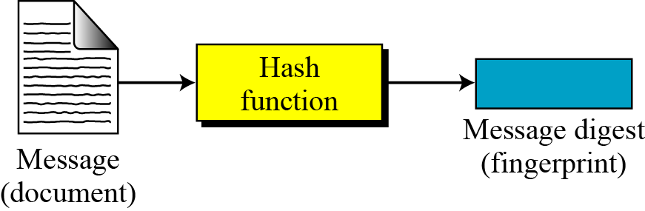
11.1.2 Message and Message Digest
The electronic equivalent of the document and fingerprint pair is the message and digest pair.
Figure 11.1 Message and digest
11.<number>

Slide 6

11.1.3 Difference
The two pairs (document / fingerprint) and (message / message digest) are similar, with some differences. The document and fingerprint are physically linked together. The message and message digest can be unlinked separately, and, most importantly, the message digest needs to be safe from change.
Note
The message digest needs to be safe from change.
11.<number>

Slide 7
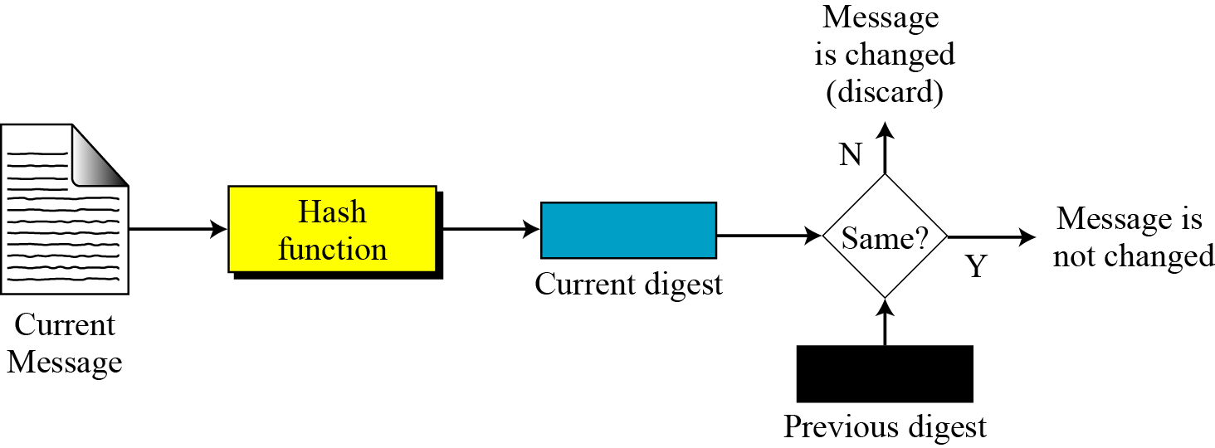
11.1.4 Checking Integrity
Figure 11.2 Checking integrity
11.<number>

Slide 8
Hash Functions
Part 1 ⎯ Cryptography Mark Stamp’s Information Security: Principles and Practices by Mark Stamp/ Deven Shah.
Copyright © 2009 Wiley India Pvt. Ltd. All rights reserved.

Slide 9
Hash Function Motivation
Suppose Alice signs M
  Alice sends M and S = [M]_{Alice} to Bob
  Bob verifies that M = {S}_{Alice}
  Is it OK to just send S?
If M is big, [M]_{Alice} is costly to compute
Suppose instead, Alice signs h(M), where h(M) is much smaller than M
  Alice sends M and S = [h(M)]_{Alice} to Bob
  Bob verifies that h(M) = {S}_{Alice}
Part 1 ⎯ Cryptography Mark Stamp’s Information Security: Principles and Practices by Mark Stamp/ Deven Shah.
Copyright © 2009 Wiley India Pvt. Ltd. All rights reserved.

Slide 10
Crypto Hash Function
Crypto hash function h(x) must provide
  Compression ⎯ output length is small
  Efficiency ⎯ h(x) easy to computer for any x
  One-way ⎯ given a value y it is infeasible to find an x such that h(x) = y
  Weak collision resistance ⎯ given x and h(x), infeasible to find y ≠ x such that h(y) = h(x)
  Strong collision resistance ⎯ infeasible to find any x and y, with x ≠ y such that h(x) = h(y)
  Lots of collisions exist, but hard to find one
Part 1 ⎯ Cryptography Mark Stamp’s Information Security: Principles and Practices by Mark Stamp/ Deven Shah.
Copyright © 2009 Wiley India Pvt. Ltd. All rights reserved.

Slide 11
Pre-Birthday Problem
Suppose N people in a room
How large must N be before the probability someone has same birthday as me is ≥ 1/2
  Solve: 1/2 = 1 − (364/365)^{N} for N
  Find N = 253
Part 1 ⎯ Cryptography Mark Stamp’s Information Security: Principles and Practices by Mark Stamp/ Deven Shah.
Copyright © 2009 Wiley India Pvt. Ltd. All rights reserved.

Slide 12
Birthday Problem
How many people must be in a room before probability is ≥ 1/2 that two or more have same birthday?
  1 − 365/365 ⋅ 364/365 ⋅ ⋅ ⋅(365−N+1)/365
  Set equal to 1/2 and solve: N = 23
Surprising? A paradox?
Maybe not: “Should be” about sqrt(365) since we compare all pairs x and y
Part 1 ⎯ Cryptography Mark Stamp’s Information Security: Principles and Practices by Mark Stamp/ Deven Shah.
Copyright © 2009 Wiley India Pvt. Ltd. All rights reserved.

Slide 13
Of Hashes and Birthdays
If h(x) is N bits, then 2^{N} different hash values are possible
sqrt(2^{N}) = 2^{N/2}
Therefore, hash about 2^{N/2} random values and you expect to find a collision
Implication: secure N bit symmetric key requires 2^{N−1} work to “break” while secure N bit hash requires 2^{N/2} work to “break”
Part 1 ⎯ Cryptography Mark Stamp’s Information Security: Principles and Practices by Mark Stamp/ Deven Shah.
Copyright © 2009 Wiley India Pvt. Ltd. All rights reserved.

Slide 14
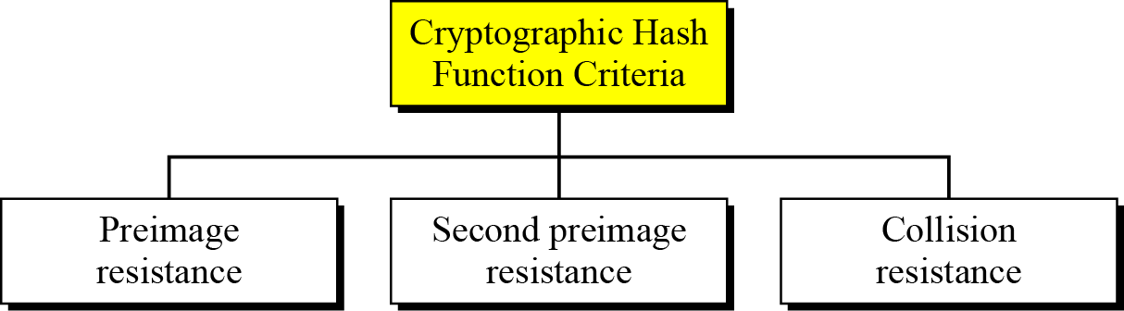
11.1.5 Cryptographic Hash Function Criteria
A cryptographic hash function must satisfy three criteria: preimage resistance, second preimage resistance, and collision resistance.
Figure 11.3 Criteria of a cryptographic hash function
11.<number>

Slide 15
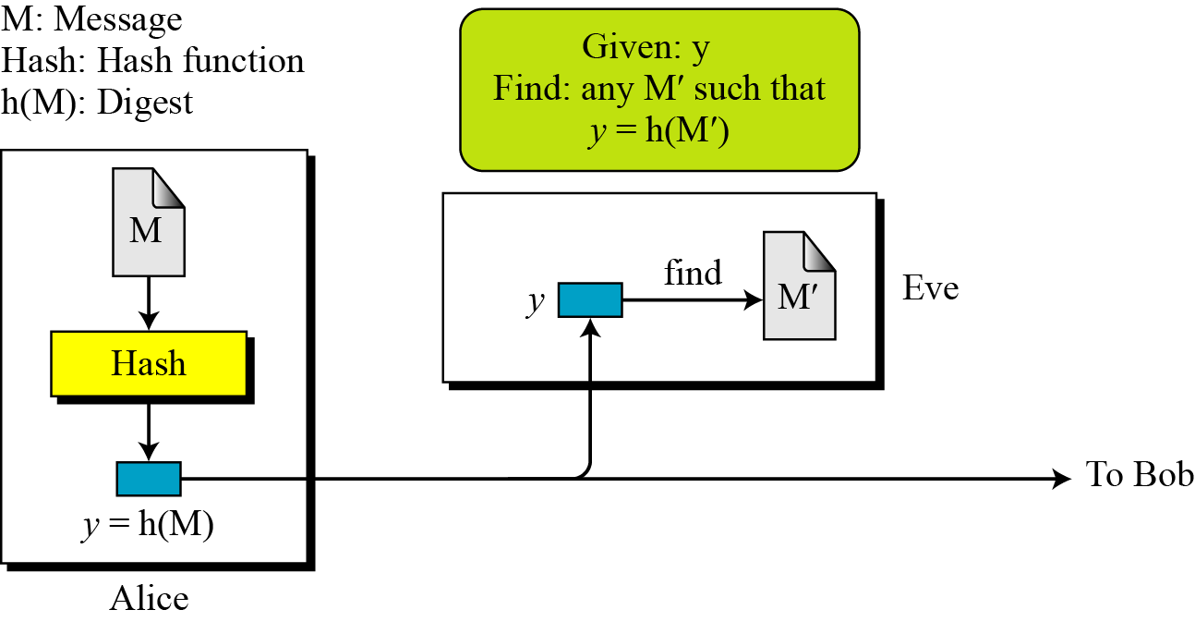
11.1.5 Continued
Preimage Resistance
Figure 11.4 Preimage
11.<number>

Slide 16
11.1.5 Continued
Example 11.1
Can we use a conventional lossless compression method such as StuffIt as a cryptographic hash function?
Solution
We cannot. A lossless compression method creates a compressed message that is reversible.
Example 11.2
Can we use a checksum function as a cryptographic hash function?
Solution
We cannot. A checksum function is not preimage resistant, Eve may find several messages whose checksum matches the given one.
11.<number>

Slide 17
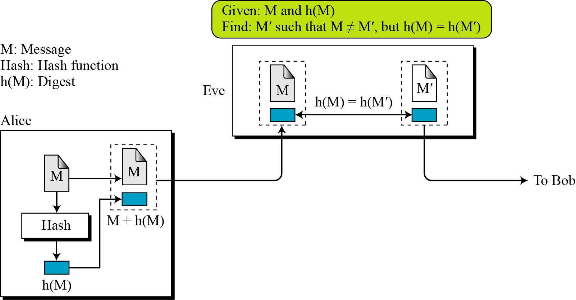
11.1.5 Continued
Second Preimage Resistance
Figure 11.5 Second preimage
11.<number>

Slide 18
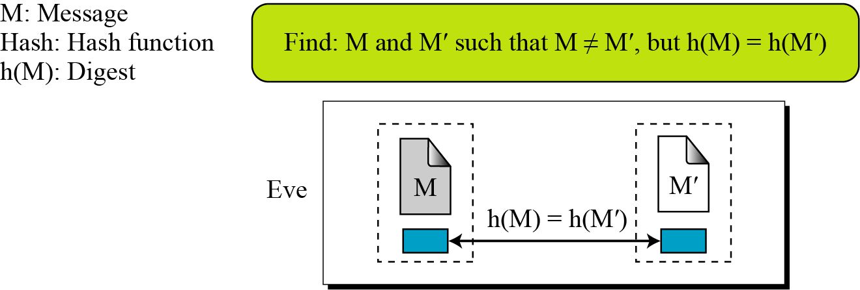
11.1.5 Continued
Collision Resistance
Figure 11.6 Collision
11.<number>

Slide 19
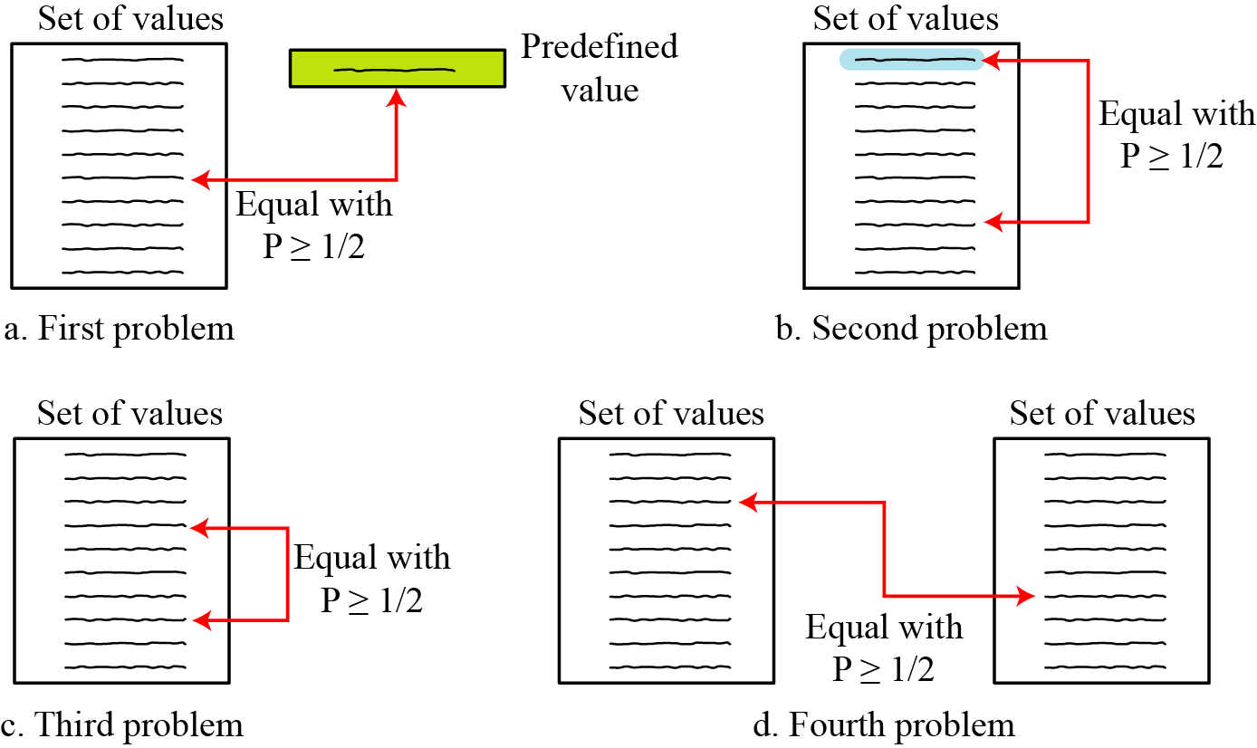
11.2.2 Birthday Problems
Figure 11.7 Four birthday problems
11.<number>

Slide 20
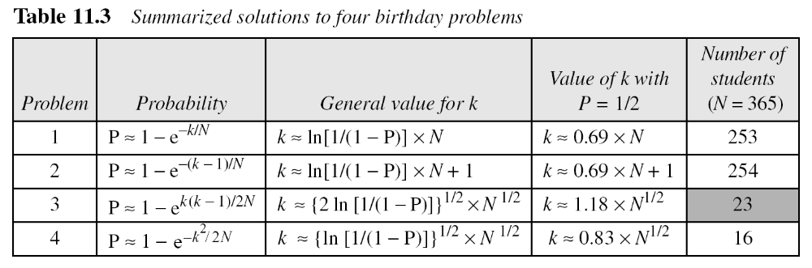
11.2.2 Continued
Summary of Solutions
Solutions to these problems are given in Appendix E for interested readers; The results are summarized in Table 11.3.
11.<number>

Slide 21
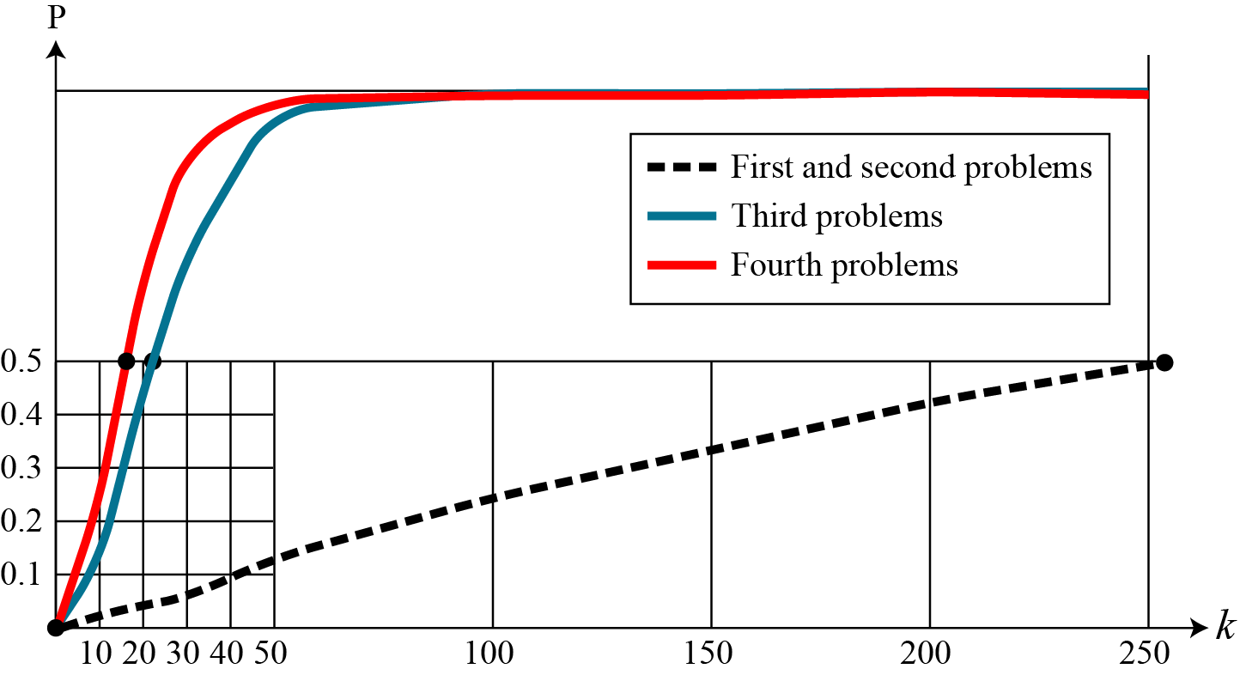
11.2.2 Continued
Comparison
Figure 11.8 Graph of four birthday problem
11.<number>

Slide 22
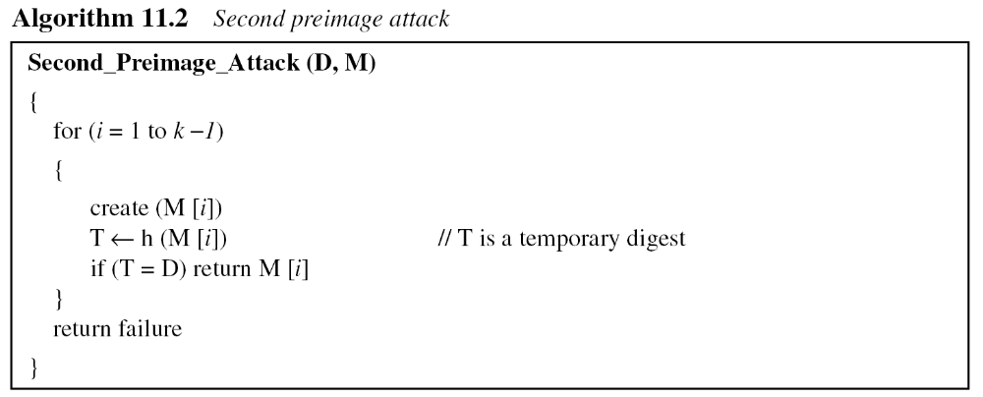
11.2.3 Continued
Second Preimage Attack.
11.<number>

Slide 23
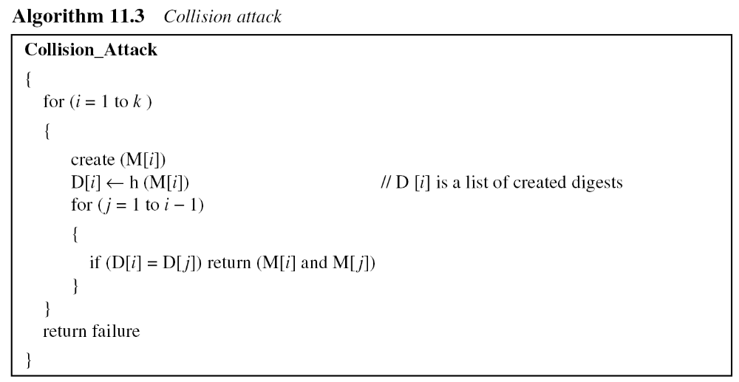
11.2.3 Continued
Collision Attack
11.<number>

Slide 24
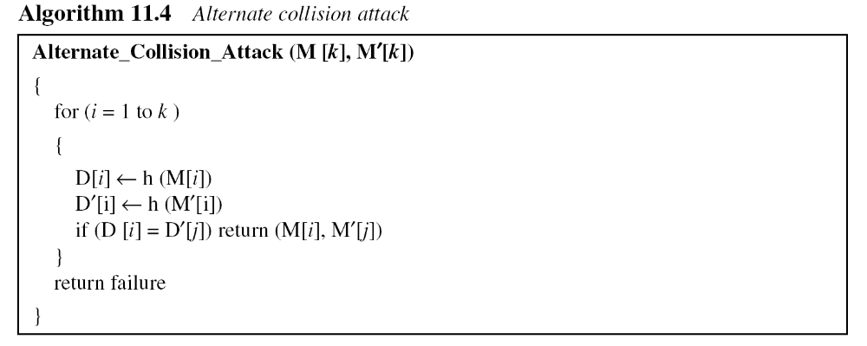
11.2.3 Continued
Alternate Collision Attack
11.<number>

Slide 25
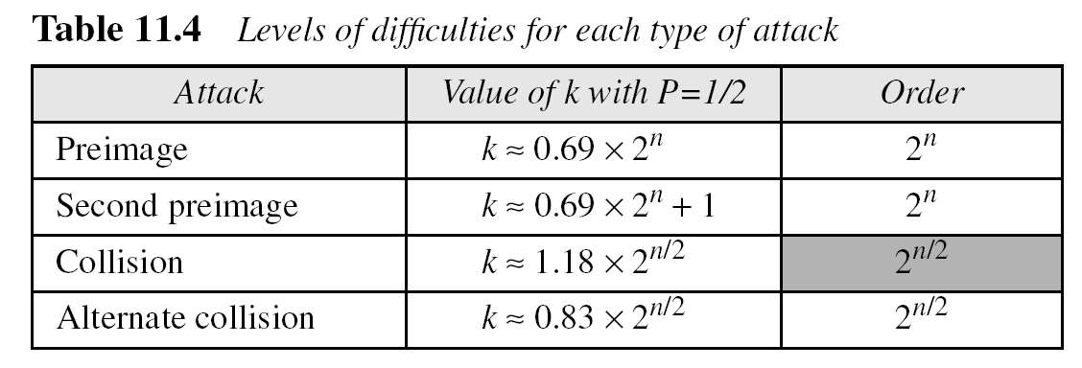
11.2.3 Continued
Summary of Attacks
Table 11.4 shows the level of difficulty for each attack if the digest is n bits.
11.<number>

Slide 26
12-1 INTRODUCTION
A cryptographic hash function takes a message of arbitrary length and creates a message digest of fixed length. The ultimate goal of this chapter is to discuss the details of the two most promising cryptographic hash algorithms⎯ SHA-512 and Whirlpool.
Topics discussed in this section:
12.1.1 Iterated Hash Function
12.1.2 Two Groups of Compression Functions
12.<number>

Slide 27
Iterated hash function
Creating a fixed size digest out of a variable size message
Creation of such function is achieved through iteration
Uses fixed size input function [Compression function] , is used necessary number of times
Compression function compresses n-bit string to a m-bit string where n>m
11.<number>

Slide 28
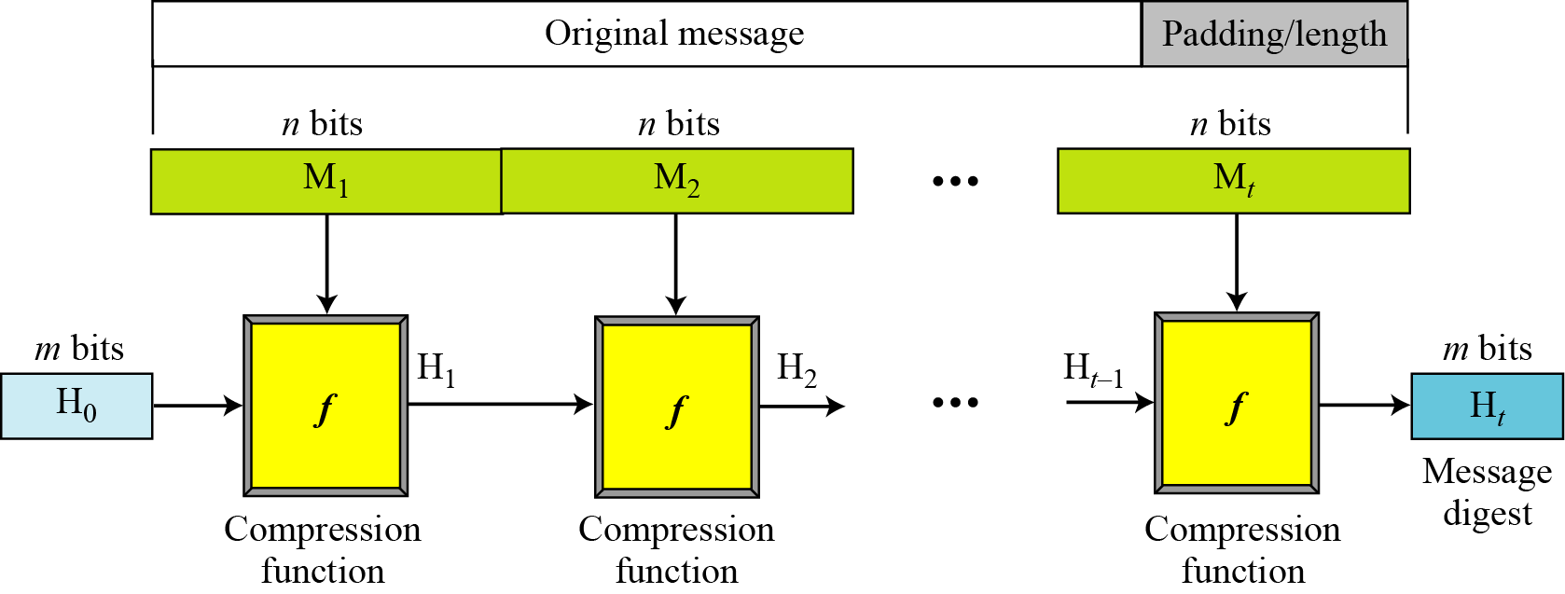
12.1.1 Iterated Hash Function
Merkle-Damgard Scheme
Figure 12.1 Merkle-Damgard scheme
12.<number>

Slide 29
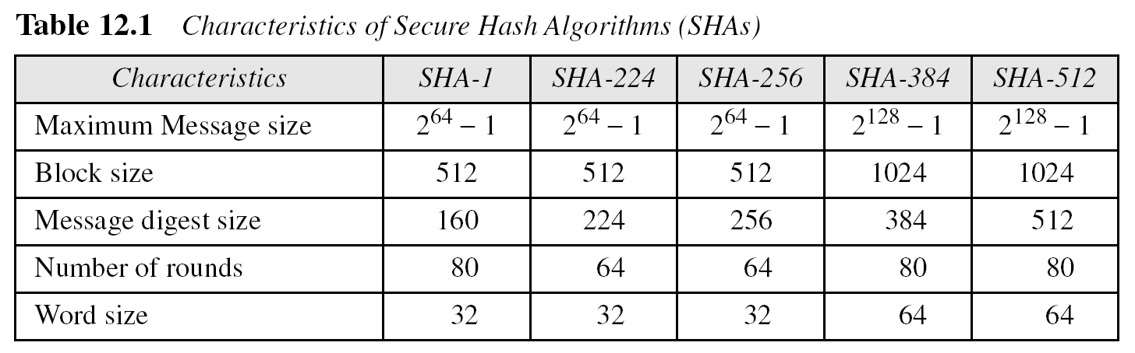
12.1.2 Continued
12.<number>

Slide 30
12-2 SHA-512
SHA-512 is the version of SHA with a 512-bit message digest. This version, like the others in the SHA family of algorithms, is based on the Merkle-Damgard scheme.
Topics discussed in this section:
12.2.1 Introduction
12.2.2 Compression Function
12.2.3 Analysis
12.<number>

Slide 31
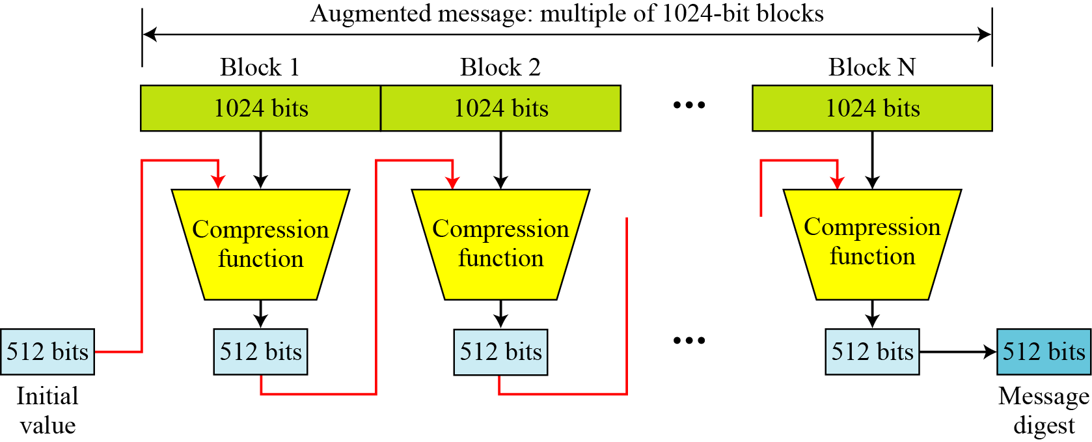
12.2.1 Introduction
Figure 12.6 Message digest creation SHA-512
12.<number>

Slide 32
12.2.1 Continued
Message Preparation
SHA-512 insists that the length of the original message be less than 2¹²⁸ bits.
Note
SHA-512 creates a 512-bit message digest out of a message less than 2¹²⁸.
12.<number>

Slide 33
12.2.1 Continued
Example 12.1
This example shows that the message length limitation of SHA-512 is not a serious problem. Suppose we need to send a message that is 2¹²⁸ bits in length. How long does it take for a communications network with a data rate of 2⁶⁴ bits per second to send this message?
Solution
A communications network that can send 2⁶⁴ [2⁶⁴ =18446744073709551616] bits per second is not yet available. Even if it were, it would take many years to send this message. This tells us that we do not need to worry about the SHA-512 message length restriction.
12.<number>

Slide 34
12.2.1 Continued
Example 12.2
This example also concerns the message length in SHA-512. How many pages are occupied by a message of 2¹²⁸ bits?
Solution
Suppose that a character is 32, or 2⁶, bits. Each page is less than 2048, or approximately 2¹², characters. So 2¹²⁸ bits need at least 2¹²⁸ / 2¹⁸, or 2¹¹⁰, pages. This again shows that we need not worry about the message length restriction.
12.<number>

Slide 35
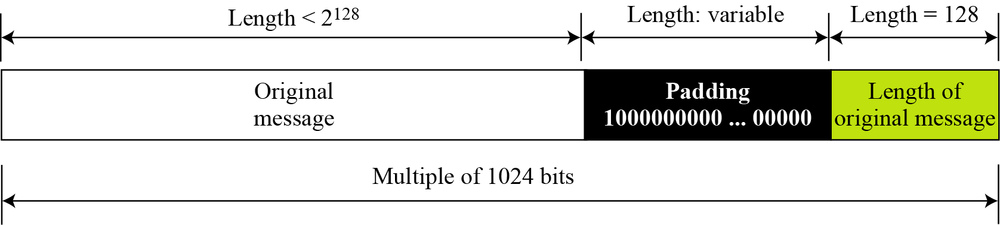
12.2.1 Continued
Figure 12.7 Padding and length field in SHA-512
12.<number>

Slide 36
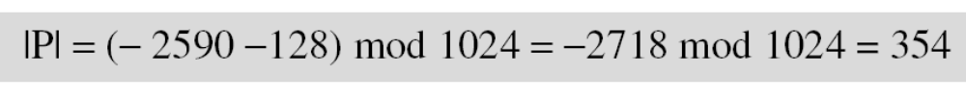
12.2.1 Continued
Example 12.3
What is the number of padding bits if the length of the original message is 2590 bits?
Solution
We can calculate the number of padding bits as follows:
The padding consists of one 1 followed by 353 0’s.
12.<number>

Slide 37
12.2.1 Continued
Example 12.4
Do we need padding if the length of the original message is already a multiple of 1024 bits?
Solution
Yes we do, because we need to add the length field. So padding is needed to make the new block a multiple of 1024 bits.
12.<number>

Slide 38
12.2.1 Continued
Example 12.5
What is the minimum and maximum number of padding bits that can be added to a message?
Solution
The minimum length of padding is 0 and it happens when
(−M − 128) mod 1024 is 0. This means that |M| = −128 mod 1024 = 896 mod 1024 bits. In other words, the last block in the original message is 896 bits. We add a 128-bit length field to make the block complete.
12.<number>

Slide 39
12.2.1 Continued
Example 12.5
Continued
The maximum length of padding is 1023 and it happens when (−|M| −128) = 1023 mod 1024. This means that the length of the original message is |M| = (−128 −1023) mod 1024 or the length is |M| = 897 mod 1024. In this case, we cannot just add the length field because the length of the last block exceeds one bit more than 1024. So we need to add 897 bits to complete this block and create a second block of 896 bits. Now the length can be added to make this block complete.
12.<number>

Slide 40
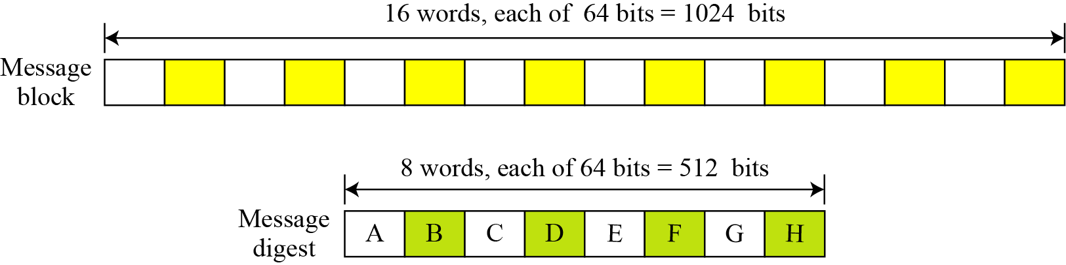
12.2.1 Continued
Words
Figure 12.8 A message block and the digest as words
12.<number>

Slide 41
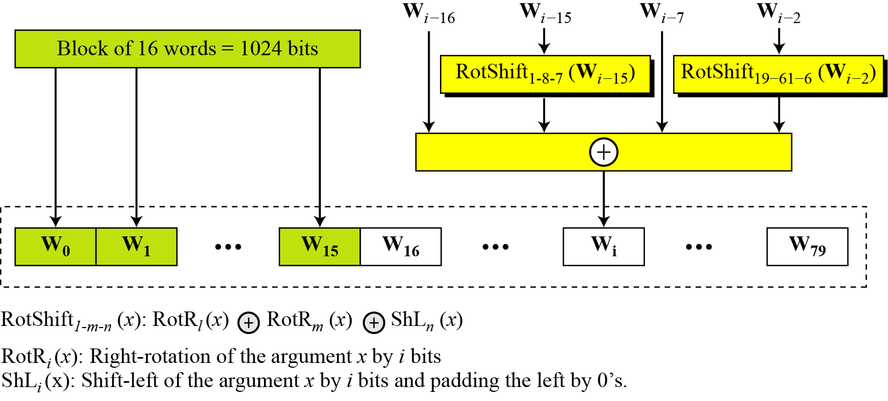
12.2.1 Continued
Word Expansion
Figure 12.9 Word expansion in SHA-512
12.<number>

Slide 42
12.2.1 Continued
Example 12.6
Show how W60 is made.
Solution
Each word in the range W16 to W79 is made from four previously-made words. W60 is made as
12.<number>

Slide 43
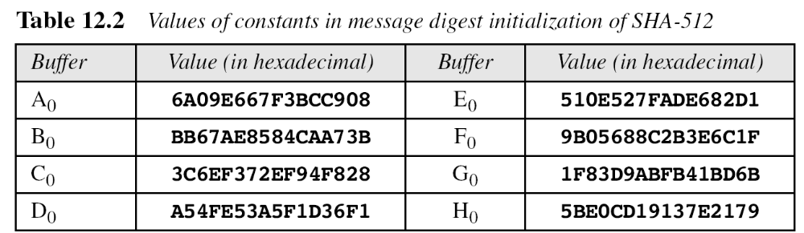
12.2.1 Continued
Message Digest Initialization
12.<number>

Slide 44
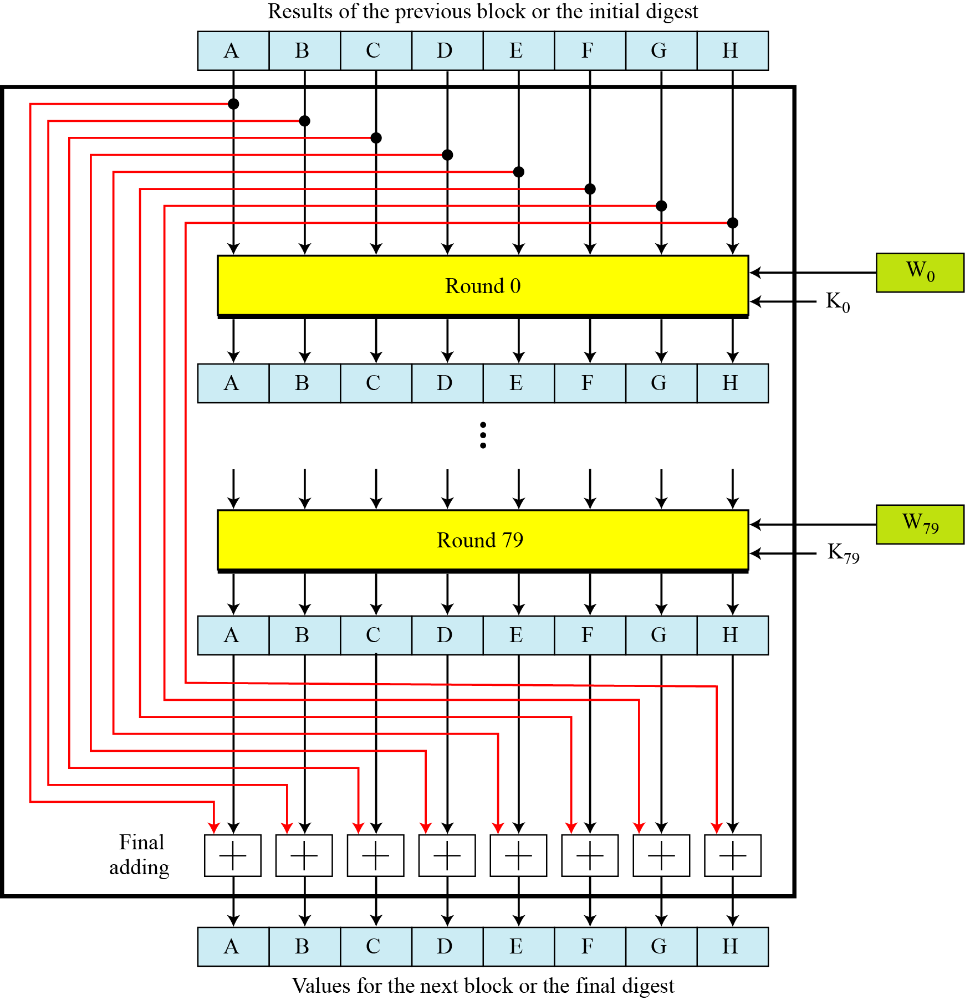
12.2.2 Compression Function
Figure 12.10 Compression function in SHA-512
12.<number>

Slide 45
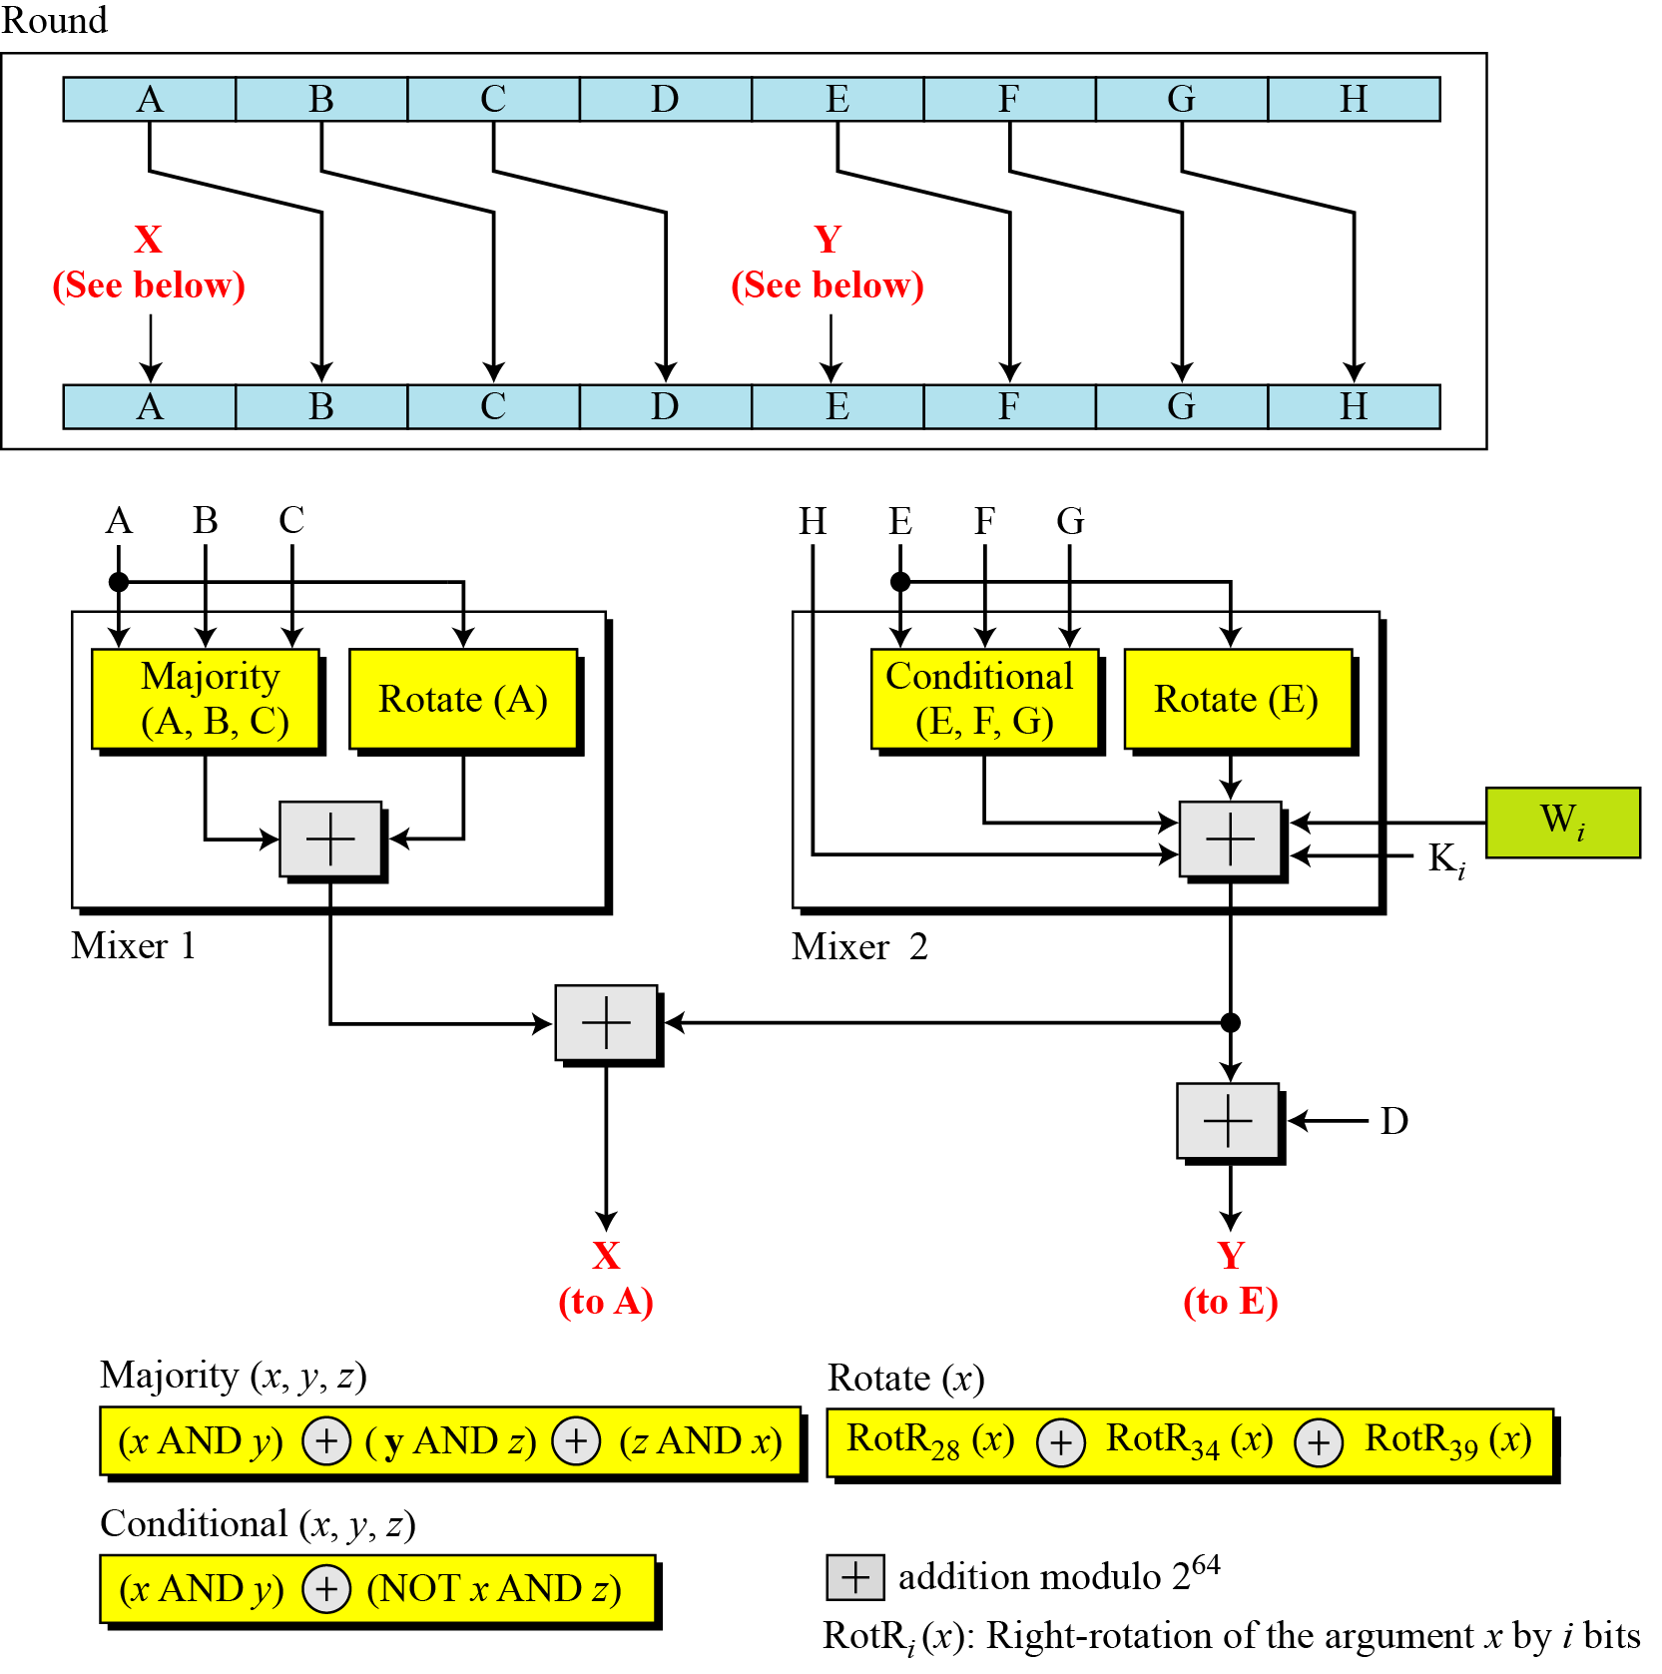
12.2.2 Continued
Figure 12.11 Structure of each round in SHA-512
12.<number>

Slide 46
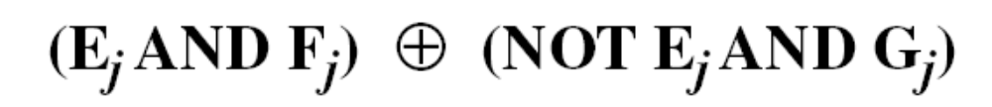
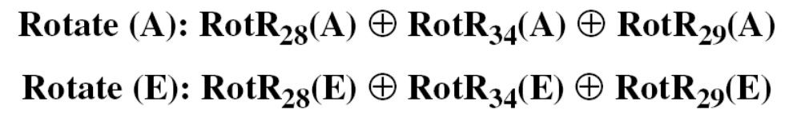
12.2.2 Continued
Majority Function
Conditional Function
Rotate Functions
12.<number>

Slide 47
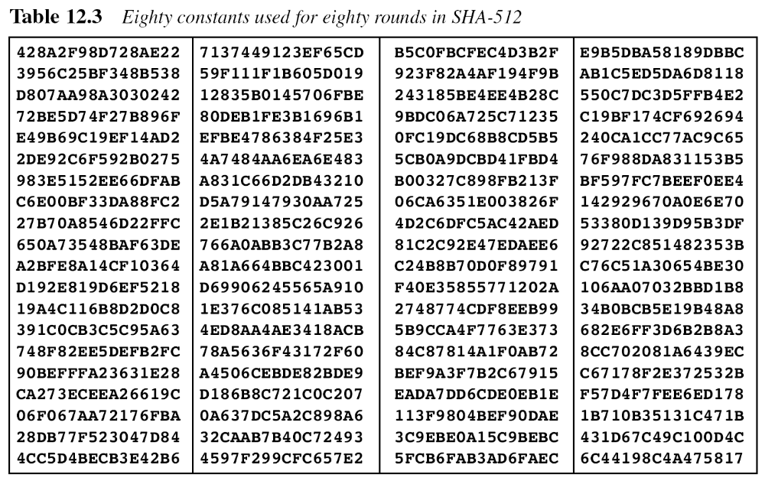
12.2.2 Continued
12.<number>

Slide 48
12.2.2 Continued
There are 80 constants, K₀ to K₇₉, each of 64 bits. Similar These values are calculated from the first 80 prime numbers (2, 3,…, 409). For example, the 80th prime is 409, with the cubic root (409)^{1/3} = 7.42291412044. Converting this number to binary with only 64 bits in the fraction part, we get
The fraction part: (6C44198C4A475817)₁₆
12.<number>

Slide 49
12.2.2 Continued
Example 12.7
We apply the Majority function on buffers A, B, and C. If the leftmost hexadecimal digits of these buffers are 0x7, 0xA, and 0xE, respectively, what is the leftmost digit of the result?
Solution
The digits in binary are 0111, 1010, and 1110.
a. The first bits are 0, 1, and 1. The majority is 1.
b. The second bits are 1, 0, and 1. The majority is 1.
c. The third bits are 1, 1, and 1. The majority is 1.
d. The fourth bits are 1, 0, and 0. The majority is 0.
The result is 1110, or 0xE in hexadecimal.
12.<number>

Slide 50
12.2.2 Continued
Example 12.8
We apply the Conditional function on E, F, and G buffers. If the leftmost hexadecimal digits of these buffers are 0x9, 0xA, and 0xF respectively, what is the leftmost digit of the result?
Solution
The digits in binary are 1001, 1010, and 1111.
a. The first bits are 1, 1, and 1. The result is F₁, which is 1.
b. The second bits are 0, 0, and 1. The result is G₂, which is 1.
c. The third bits are 0, 1, and 1. The result is G₃, which is 1.
d. The fourth bits are 1, 0, and 1. The result is F₄, which is 0.
The result is 1110, or 0xE in hexadecimal.
12.<number>

Slide 51
12.2.3 Analysis
With a message digest of 512 bits, SHA-512 expected to be resistant to all attacks, including collision attacks.
12.<number>

